Slide 1
Automation in Attendance system
ANCHAL SINGH (17BT030406)
ELECTRONICS AND COMMUNICATION ENGINEERING
RGGEC KANGRA H.P

Slide 2
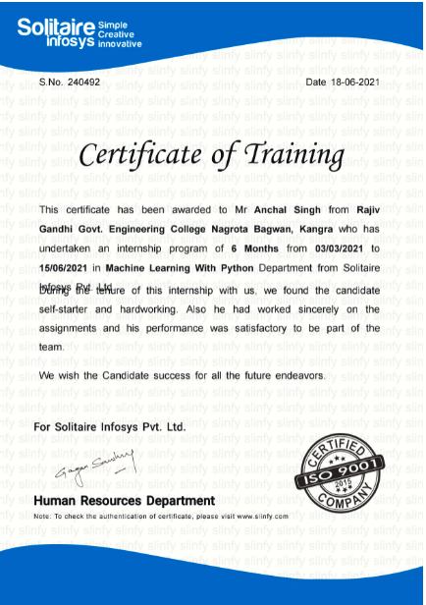

Slide 3
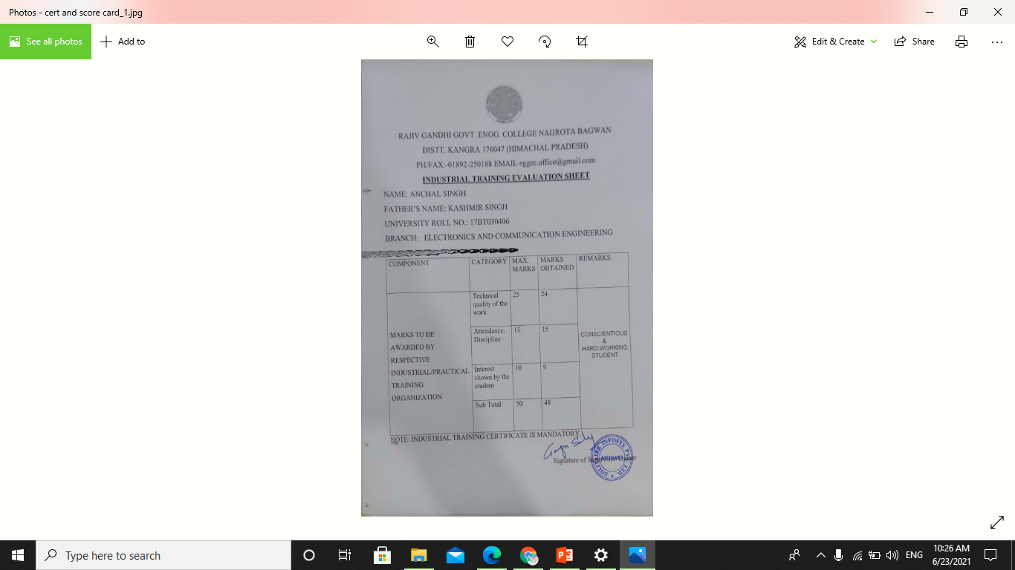

Slide 4
CONTENTS
What is python?
Applications of Python
Modules covered during training
Image Processing
Introduction to project work
Stages of work
Hardware and Software tools
Sample outputs
References

Slide 5
WHAT IS PYTHON ?
High level programming language for general purpose programming
Supports multiple programming paradigms like OOP’s, functional, and procedural programming
Support a large and comprehensive standard libraries
Support multiple platform
Current versions in use are Python 3.x and 2.x
Created by Guido Van Rossum in 1991

Slide 6
Applications of Python
Web Development
Web Testing
Game Development
Machine Learning/Artificial Intelligence
Data Science
Robotics
Internet of things (IOT)

Slide 7
Modules covered during training
Tkinter
Numpy
Matplotlib
Opencv
Machine Learning algorithms
Image Processing

Slide 8
Image processing
Image processing is a method to perform some operations on an image , in order to get an enhanced image or to extract some useful information from it
Image processing mainly include the following steps:
Importing the image via image acquisition tools;
Analyzing and manipulating the image;
Output in which result can be altered image or a report which is based on analyzing that image.

Slide 9
Introduction to project work
Automation in attendance system means shifting from manual to automatic
Face is unique feature of every individual
Face recognition and detection are main principles of this work
Advantageous in time saving
Can be an X-factor in security systems
Reduces the headache of maintaining data manually

Slide 10
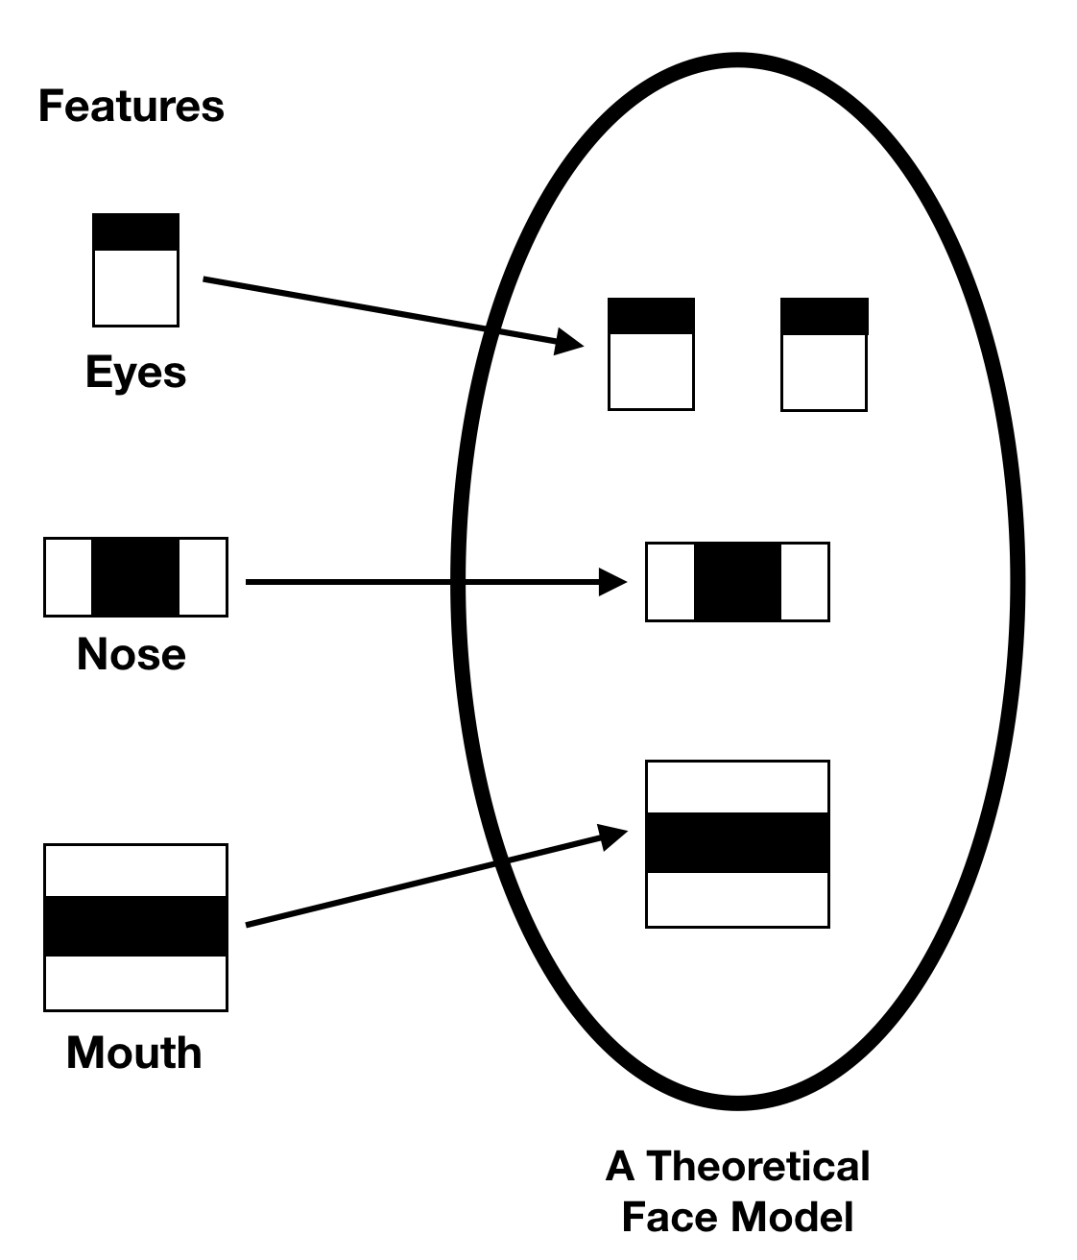
Face extraction
An input image is scanned at all possible locations and scales
Haar like features are rectangular patterns in data
Cascade is a series of Haar-like features that are combined to form a classifier
Weak classifiers are combined to form a strong classifiers

Slide 11
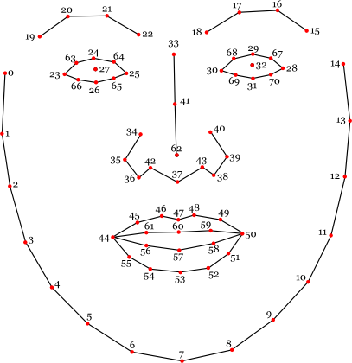
Face extraction
Facial landmarks detection or facial keypoints detection has a lot of uses in computer vision like face alignment, drowsiness detection, Snapchat filters .
The most widely known model for this task is Dlib’s 68 keypoints landmark predictor which gives very good results in real-time.

Slide 12
Stages of work
Collection of dataset
Training on dataset
Face Detection and mark attendance

Slide 13
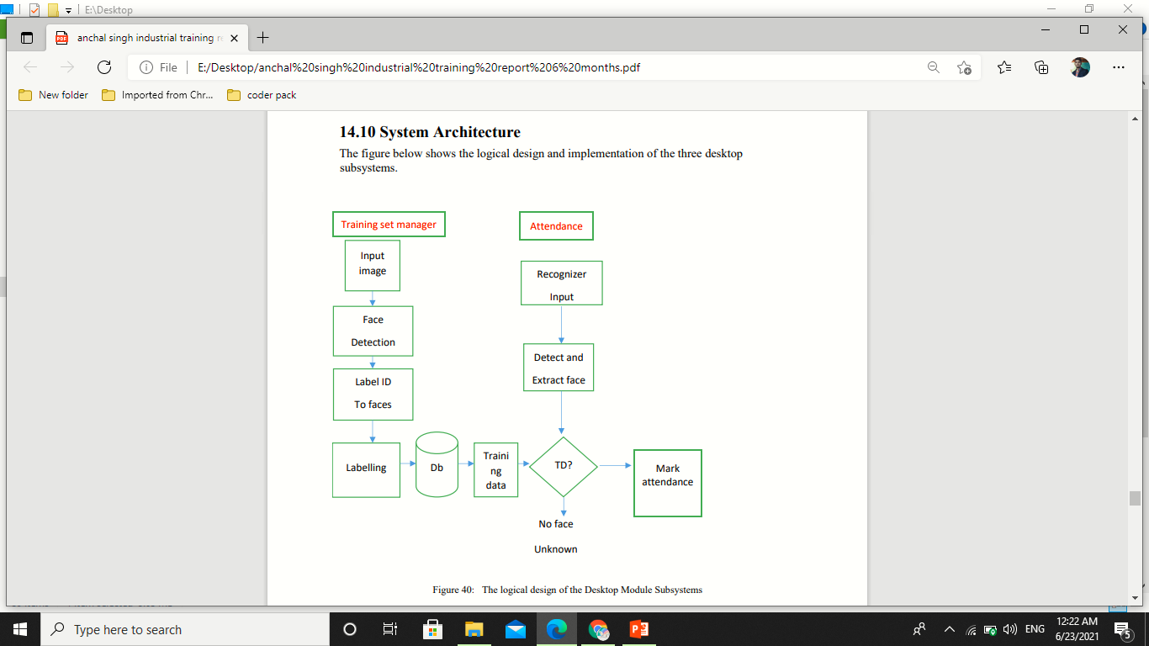
Stages of work

Slide 14
Hardware and Software tools
Python
Opencv
Numpy
Tkinter
Csv
Web-cam

Slide 15
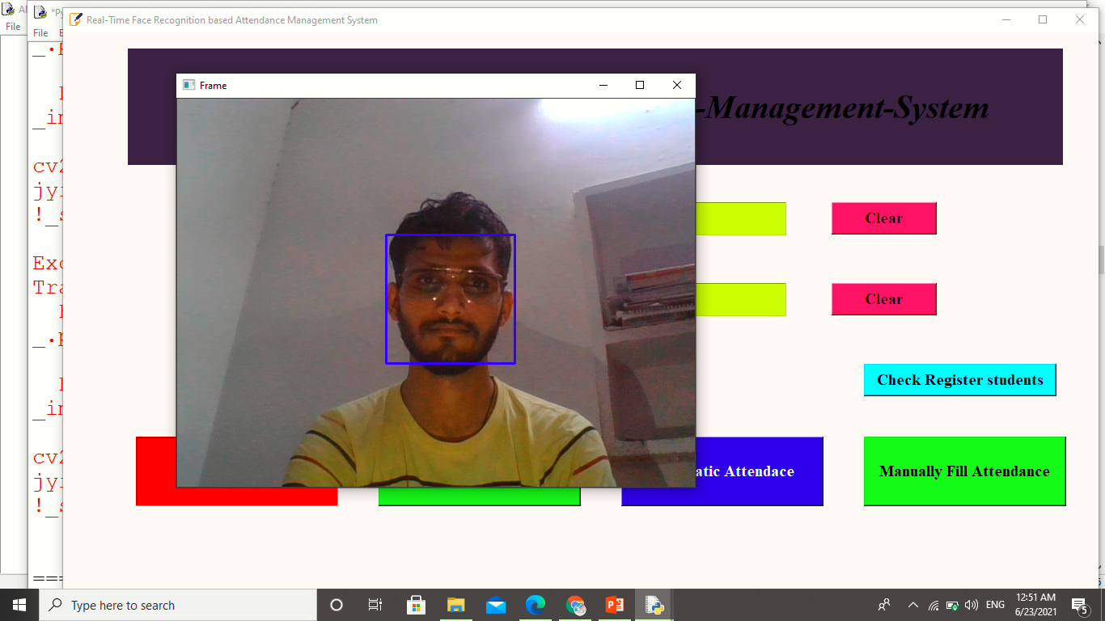
Collecting Data

Slide 16
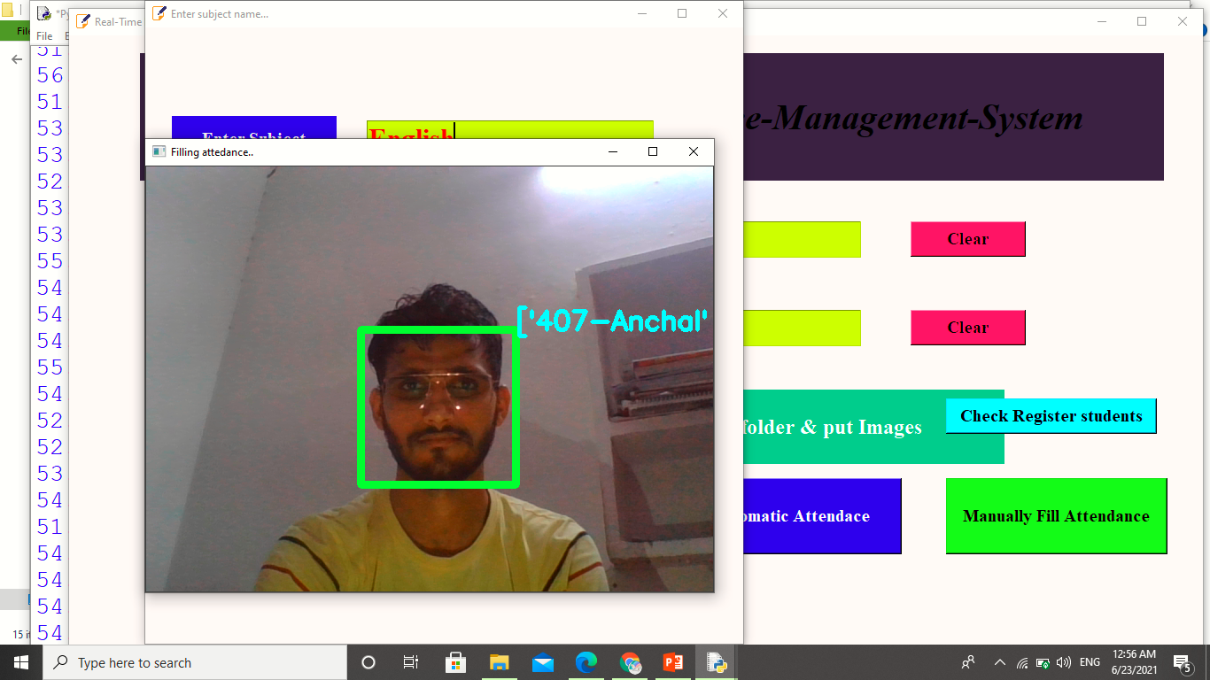
Automating Attendance

Slide 17
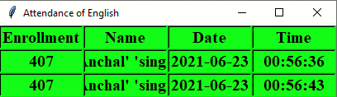
Data stored in sheets

Slide 18
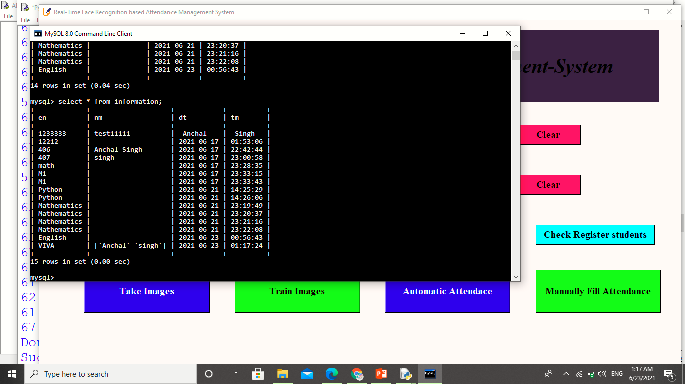
Data Stored in the Database

Slide 19


